Slide 1
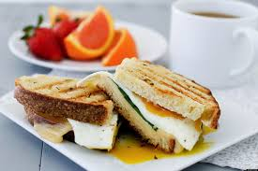
Breakfast Preparation
Food Service Occupations I
Unit 5

Slide 2
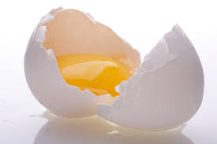
Breakfast Preparation Overview
Eggs are the most popular breakfast item in a restaurant because they can be prepared in many ways.
Simple preparations, such as scrambled eggs, are quick to cook.
More complex preparations, such as shirred eggs, require more time.
Pancakes are also popular on the breakfast menu.
Pancake batter can be prepared before cooking, and cooking time is minimal.
Pancakes are served with different toppings for variety.

Slide 3
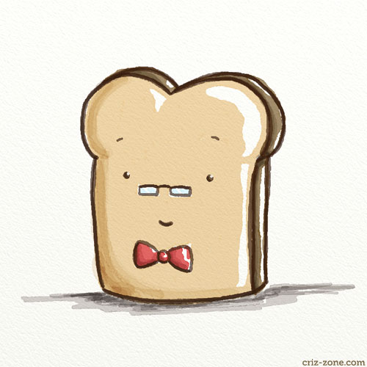
Breakfast Preparation Overview Cont.
Breakfast meats, usually bacon, sausage, or ham, can also be prepared quickly.
Potatoes are usually fried for quick preparation.
Cereals, hot or cold, can be prepared in individual servings.
Juices are served in small glasses, and fruits, such as grapefruit, oranges, and cantaloupe are prepared cold.
Toast and pastry items are also served
on the side or eating with coffee or juice.

Slide 4
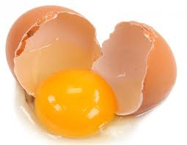
Eggs
Eggs can be used in breakfast preparation, as well as luncheon and dinner entrees.
In fact, eggs, like cheese, are a food that may be used in any part of the menu from appetizer to dessert.
Eggs are relatively inexpensive and can help hold food costs down.
The commercial kitchen should always have eggs available.
Eggs can be used in a variety of ways…
Thickening or binding agent (custard filling, meatballs)
Adhesive agent (breading/coating)
Emulsifying agent (hollandaise, mayonnaise)
Clarifying agent (consommé)
Leavening agent (sponge cake)
Entrée (eggs benedict)

Slide 5
Eggs
Eggs are classified as grades:
Grade AA: a very fancy egg
Grade A: top grade egg
Grade B: good quality egg
Grade C: below average egg
**Grades B and C are commonly used in bakeries where flavor and presentation are not as important as its function in the cooking method.
Eggs are classified as size:
Jumbo: +30 oz. per dozen
Extra Large: 27-30 oz.
Large: 24-27 oz. (most common)
Medium: 21-24 oz.
Small: 18-21 oz.
**Eggs in fresh form are more versatile in the commercial kitchen and can be purchased in bulk.

Slide 6
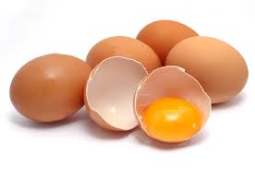
Eggs
Rule :Store eggs in refrigerator to maintain freshness.
Rule : Store egg yolks with water (keeps from drying out)
Rule : Store egg whites in airtight container up to 1 week.
Cooked eggs perish quickly due to their delicate nature. Best results are cooking eggs in small quantities and cooking close to serving time.

Slide 7
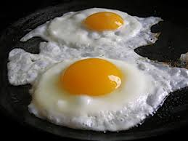
Egg Cooking Methods
Fried Eggs should always be fried in either butter, shortening, or margarine but never bacon grease. Also for best results fry to order and use the correct size skillet. Slide eggs into a fairly moderate temperature so the hot fat will solidify the whites of the eggs and not spread. At this point reduce the heat immediately to avoid a hard, brown surface under and around the edge of the eggs.
Fried Egg Faults
Frying with too much fat
Using poorly conditioned pans
Frying at a low temperature
Frying with little fat
Frying at too high of a temperature
Fried Egg Entrees
Sunny Side Up: lightly cooked with yolks unbroken
Eggs over Easy: flipped over and cooked easy (lightly), medium, or hard (well)
Basted Eggs: lightly cooked with yolks unbroken and finished under the broiler
Country Style: served with ham, bacon, or sausage

Slide 8
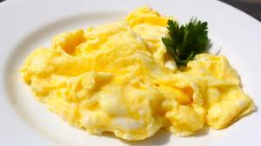
Egg Cooking Methods
Scrambled Eggs is the easiest method when preparing eggs in large quantities. Scrambled eggs may be prepared in several ways. Eggs can be scrambled in a well-greased pan in the oven, steam jacket kettle, in a double boiler, in a steamer, or in a skillet on the range. Always break eggs in a stainless steel or glass bowl, but never aluminum because it will discolor the eggs. Beat the eggs slightly with a wire whisk or fork, and add a small amount of water, cream, or milk for tenderness. Pour eggs into a heated, greased, or buttered skillet so the eggs will start to coagulate immediately. Reduce heat and lift the eggs from the bottom. At the same time, stir gently with the kitchen spoon so the uncooked portion will settle to the bottom and cook.
Scrambled Egg Faults
Excessive stirring when cooking
Cooking too high of a temperature
Scrambled with too little fat
Scrambled eggs with too much fat
Holding cooked eggs to long
Scrambled Egg Tips
Should be soft and fluffy
Always undercook scrambled eggs slightly, as they will become firm when held for service
Never overcook scrambled eggs because they will become hard and unpalatable

Slide 9
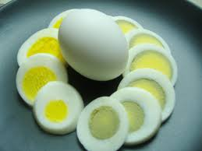
Egg Cooking Methods
Boiled or Simmered Eggs should actually be simmered and never boiled for best results. Boiling tends to toughen the texture and can create a green coating around the outside of the yolk. Simmering is approximately 195° degrees opposed to boiling at 212 ° degrees. Eggs should also be at room temperature before they are placed in the hot water, or they may crack. If the eggs are left in the refrigerator until it is time to cook them, run warm water over the eggs before placing them in the water. A boiled egg is pealed by cracking the shell gently on a hard surface or by rolling it on a hard surface. Place the egg under running cold water and start peeling at the large end of the egg and peel downward.
Boiled/Simmered Egg Faults
Cooking at too high of a temperature that causes a tough, rubbery texture and green ring around the yolk
Cooking at too low of a temperature that causes it to be undercooked
Boiled or Simmered Egg Boiling Method #1
Bring water to boil (212 °)
Place eggs in boiling water
Reduce heat to simmer (195°)
Soft= 3-5 minutes
Medium= 7-8 minutes
Hard= 15-17 minutes
Boiled or Simmered Egg Boiling Method #2
Place eggs in pot of cold water
Bring water to a boil (212 °)
Reduce heat to simmer (195°)
Soft= 1-2 minutes
Medium= 3-6 minutes
Hard= 8-10 minutes

Slide 10
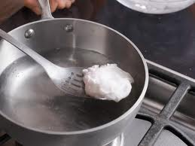
Egg Cooking Methods
Poached Eggs should be cooked in a fairly shallow pan with enough water (~2 ½”) to cover the eggs. Add 2 T. of distilled vinegar to each gallon of water. The salt and vinegar will cause the white to set firmly around the yolk when the egg is placed in the water, thus stopping the white from spreading. The acetic acid of the vinegar toughens the albumen (contained in the egg white), and when the white is set firmly around the yolk, a more eye appealing product is obtained.
Poached Egg Faults
Too much vinegar added to liquid
Cooking at too low of a temperature and causes tenderness
Cooking at too high of a temperature and causes toughness
Poached Egg Steps
Bring the liquid to a boil, then reduce to a simmer (~195°).
Break the eggs into a bowl or saucer and slide them into the simmering liquid.
Cook 3-5 minutes.
Remove with a skimmer, perforated ladle, or slotted spoon.
**About 12 eggs can be poached per gallon of water

Slide 11
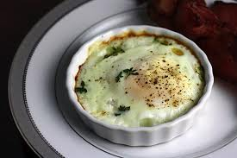
Egg Cooking Methods
Shirred Eggs are eggs that have been cooked in a shallow casserole with butter. When served on the breakfast or luncheon menu, shirred eggs present a very attractive dish. Shirred eggs must be prepared in a proper manner and not overcooked.
Shirred Egg Faults
Cooking at too high of a temperature where eggs become tough
Cooking at too low of a temperature and eggs spread and the yolk breaks
Shirred Egg Steps
Break eggs into a bowl then into buttered shirred egg dish.
Place shirred egg dish on the range and cook at medium heat until the whites are set.
Finish by transferring the dish to the oven or by basting the top of the eggs.

Slide 12
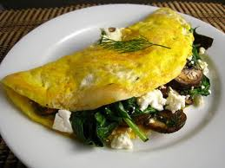
Egg Cooking Methods
Omelets can be found on breakfast, lunch, and even dinner menus. The omelet is very versatile because it blends well with other foods. When an omelet is served with another item such as bacon, mushrooms, or Spanish sauce, it takes the name of the accompanying item; for example, Spanish omelet. Omelets should be made to order for best results. If they are held for even a short period of time, they lose their fluffiness and become tough and rubbery. When preparing omelets for the breakfast menu, two or three eggs are usually the rule.
Omelet Faults
Too little fat in the pan
Poorly conditioned skillet
Overcooking
Too much fat in the pan
Cooking omelet too far in advance
Omelet Types
Rolled Omelet
Folded Omelet
.

Slide 13
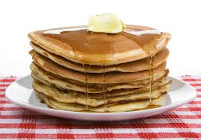
Pancakes
Another popular breakfast preparation is pancakes, also known as hotcakes or griddle cakes.
Pancakes are popular because they are easy to digest, can be served in a variety of ways, and usually have a low menu price.
Pancakes must always be cooked to order and served piping hot on a hot plate or platter with butter and topping such as jam, jelly, or syrup.
Pancakes cost very little to make even when featured with a high-cost accompaniment such as strawberries, cherries, blueberries, or ice cream.
Pancakes blend well with meat, and when served for breakfast, they are usually accompanied by sausage, ham, or bacon.
Most food service establishments find that it is more profitable to use pancake mix than mixing their own.
The better mixes call for milk, oil, and eggs.
Although, as the number of ingredients increases, the time saved decreases.
Types of pancakes include plain, buttermilk, French, crepes, and waffles.

Slide 14
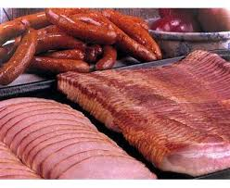
Breakfast Meats
Breakfast meats commonly include sausage, bacon, and ham.
All of these breakfast meats come from pork.
Bacon and ham are cured by
smoking, whereas most sausage is fresh.
These meats are usually precooked and reheated for service when the breakfast volume is large.
When the volume is small, they are cooked to order.

Slide 15
Breakfast Sausage
Breakfast sausage is available in the forms of patties and links.
Patties are usually portioned into 1-2 oz. servings.
Sausage patties can be precooked by baking on sheet pans in the oven at 350° F, cooking in a skillet on the range, broiling under the broiler, or grilling on the griddle.
Whichever method is used, sausage patties should be cooked about three-quarters of the way and finished when ready to serve.
Sausage links average about 12 to a pound.
The portion served for breakfast is generally 3-4 links.
Sausage links are cooked by separating the links, placing them on sheet pans, baking at 350° F until three-quarters done.
Then, drain off excessive grease and finish under broiler.

Slide 16
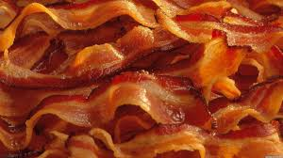
Bacon
Bacon may come by the slab or sliced.
Sliced bacon contains approximately 20-22 slices per pound.
Bacon is cooked by separating the slices and placing them on a sheet pan fat side down with each slice slightly overlapping the other.
The bacon is baked at 350° F until three-quarters done.
Remove the bacon from the oven, pour off the grease, and drape over a platter.
This draping method keeps the bacon from lying in the grease, as well as prevents it from shrinking and curling.

Slide 17
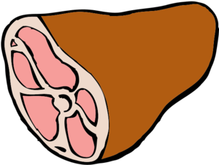
Ham
Ham is usually purchased cooked in a form that is boneless or boned and rolled.
This form gives superior shape and allows the meat to portion into 3-4 oz. pieces.
Ham is just heated under a broiler, a griddle, or in a skillet.
Canadian bacon is very popular but expensive.

Slide 18
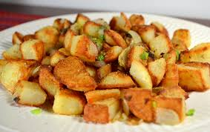
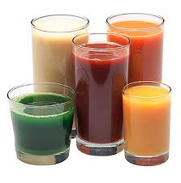
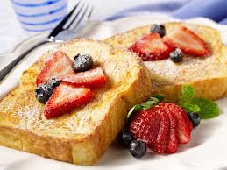
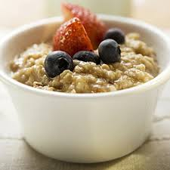
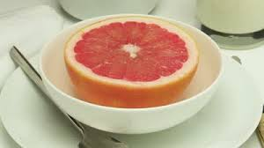
Misc. Breakfast Foods
Potatoes | Cereals | Juices | Fruits | Toast
*Usually fried *Hash brown *Home Fries | *Hot/Cold cereals *Oatmeal *Raisin Bran, etc. | *Fruit/Vegetable juice *Orange *Tomato | Fresh, Canned, Frozen *Grapefruit *Oranges *Melons | *White *Cinnamon *French Toast

Slide 19
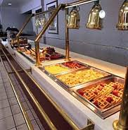
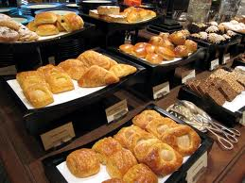
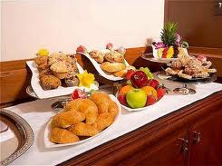
Types of Breakfast
Breakfast Buffet | Pastries | Continental Breakfast
Displays food in an appetizing manner to stimulate the appetite. Food examples would be scrambled eggs, hash brown potatoes, ham, pancakes, etc. The secret is to offer a variety of foods that are well prepared, arranged, priced well. | Pastries could include sweet rolls, doughnuts, coffee cakes, and Danish pastries. Always serve pastries warm when possible. | A very popular type of breakfast in European countries is now growing in the United States. This type of breakfast includes light offerings such as toast or pastries, fruits, juices and/or coffee.

