Slide 1
Greece by Mrs. Webster
The stripes represent the sea and waves which surround the country on all sides but the North.

Slide 2
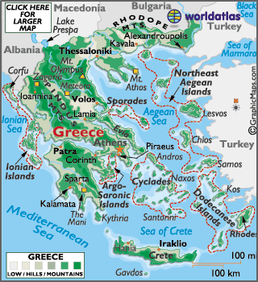
The Land
Located at the southeastern corner of Europe.
Famous for its jagged coastline (Aegean Sea, Mediterranean Sea, and the Ionian Sea).
Occupied by plains which are surrounded by either mountains or the sea.

Slide 3
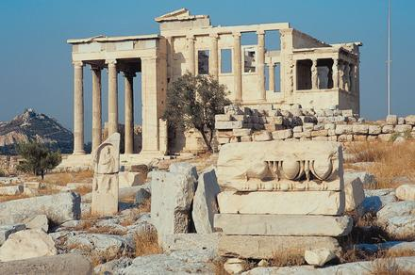
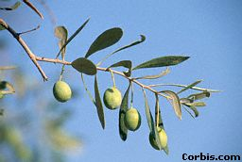
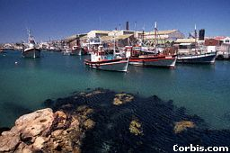
The History
Following the invasion of the Turks, and what ended in the Independence War, Greece had finally become independent. Even as Greece still strives to gain a role in world affairs after centuries of political and cultural oppression , a deep sense of cultural unity has preserved this rich society. Greece has grown to promote it’s agriculture, tourism, shipping, and construction throughout the country.
Farmers grow olives, grapes, melons, peaches, tomatoes and oranges. Grapes are also grown to make wine.
The Acropolis in Athens remains a tribute to Greek architecture.
Greece is surrounded by water which makes transportation and fishing two strong economic sectors.

Slide 4
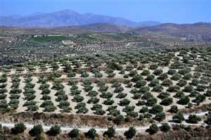
The People
Greeks are partly descended from the ancient Greeks.
Greek is the official language.
Greek was traditionally poor agriculturally but now makes the most from its produce.
Greek cuisine has diverse cooking styles, ingredients , and flavors, some incorporated from other countries like France and Italy.
Vegetarianism has a long tradition in the Greek culture.

Slide 5
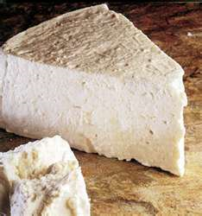
The Food
Food | Misc. Facts
Feta & Yogurt | Backbone of Greece’s dairy industry. Feta is only made with sheep and goat’s milk.
Olives | Greece is the largest producer of olive oil and is used in almost every Greek cooking method.
Herbs & Spices | Greece has ample amount of sunshine and variability of landscape in order to grow sage, thyme, oregano, basil, and red saffron.
Legumes | Chickpeas are commonly used in dishes like hummus.
Meats | Lamb is commonly used in dishes like gyros.
Seafood | Greece is surrounded by the sea which makes tuna, bass, swordfish, octopus and squid popular.
Fruits & Vegetables | Fresh and dried fruit are commonly used in everyday dishes even desserts.

Slide 6
The Food: Cuisines
Geography and history are two important factors in culinary traditions.
Type of Greek Cuisine | Specialty Restaurant
Large Casseroles | Tavernas (café )
Stews
Grilled Meats | Psistaries (grill house)
Seafood
Phyllo Items | Laiko (village cuisine which means at home or bought)

Slide 7
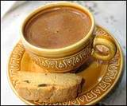
The Food: Meals
Breakfast | Lunch | Dinner
7 AM | 2-3 PM | 10 PM
Light Meal Greek Coffee brewed with water and honey and accompanied by a roll with butter or jelly. | Main Meal Appetizer, meat or fish, salad, yogurt with fresh fruit and honey | Appetizers in early evening (before dinner) and usually accompanied with wine in moderation.

Slide 8
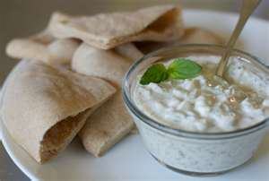
The Recipe
Tzatziki Dip
Ingredients:
Plain yogurt, shredded cucumber, garlic cloves, olive oil, lemon juice, salt and pepper.
**Serve chilled with crusty bread or on gyros**

