Slide 1
Quickbread Preparation
Food Service

Slide 2
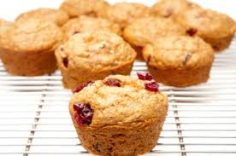
Quickbread Preparation
Quickbreads are easy to prepare compared to
other baked goods. Although they are easy to prepare, quickbreads are very important to the success of the food service establishments. Customers want and expect high quality quickbreads.
Quickbreads are so named because of the quick-acting leavening agent used in their preparation. This allows the quickbread mixture to be taken directly from the mixer, made up, and baked without waiting for the dough to rise. There are many types of quickbreads, each requiring specific recipes. All quickbread recipes should result in a product that supplies tenderness, moisture, leavening, flavor, and body.
Common quickbread preparations include biscuits, muffins, corn bread, and quick loaf breads. Quickbreads can be served at any meal and are chosen for a particular meal based on the menu. Ingredients such as nuts, fruits, vegetables, whole wheat flour, rye flour, and cornmeal are commonly added, which makes quickbreads one of the most versatile preparations in the commercial kitchen.

Slide 3
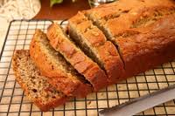
Quickbread Preparation
A quickbread is a baked product that is quick to mix; uses quick-acting leavening agents such as baking powder, baking soda, or steam; and bakes in a short period of time. Quickbread items would include biscuits, muffins, corn bread, and corn sticks. Pancakes and waffles are also considered a quickbread.
Quickbread is usually made with six basic ingredients:
Flour
Sugar
Shortening
Salt
Oil
Milk
Eggs

Slide 4
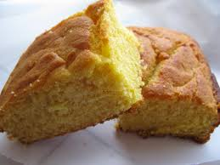
Quickbread Preparation
Quickbreads have acquired their
name because they are made with a quick-acting leavening agent, such as baking powder or baking soda, instead of the slower-acting yeast. Quickbreads can be prepared in a comparatively short time since the mixture is taken directly from the mixing machine, made up, and baked, There is no waiting period of one or more hours for gases to develop to leaven the dough.
Leavening is a chemical, biological, or physical reaction that causes baked products to rise, increase in volume, and become light. Successful quickbreads require high-quality ingredients and good recipes.

Slide 5
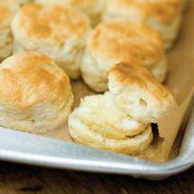
Biscuits
Biscuits can be made using many different recipes. A biscuit is a light, layered quickbread made with baking powder or baking soda. Eggs are not commonly used in biscuits, and shortening is used instead of oil. However, all contain the same basic ingredients with amounts and procedures varying.
Biscuit Basic Ingredients:
Flour
Sugar
Baking powder
Salt
Shortening
Milk
Eggs and butter may be added to improve the tenderness and richness of the biscuits, as well as cheese to vary the flavor.

Slide 6
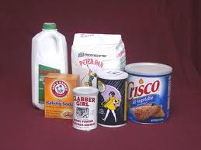
Biscuits
Shortening is considered the most
important ingredient in preparing biscuits because it supplies tenderness. Baking powder and baking soda are the quick-acting leavening agents that cause the dough to rise when liquid is added and heat is applied. Flour supplies body, form, and texture to the biscuit. Milk provides moisture, regulates the consistency of the dough, develops the flour, and causes the baking powder to generate its gas. Salt brings out the flavor and taste of the other ingredients. Sugar supplies sweetness, helps retain moisture, and helps provide the golden brown color desired.

Slide 7
2 Types of Biscuits
Cake Biscuit
Flaky Biscuit
This type of biscuit is mixed to a very smooth dough.
This biscuit is mixed like a pie crust due to the high percentage of shortening. The shortening is cut into the dry ingredients and the liquid is added slowly and blended gently until a dough is formed.

Slide 8
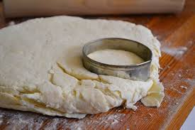
Biscuit Cutting
Roll biscuit dough to a ¾ “ thickness.
Dip biscuit cutter in flour and cut biscuits.
Place biscuits close together on sheet pan.

Slide 9
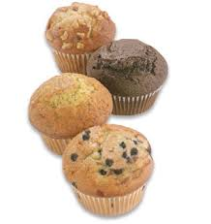
Muffins
Muffins are a popular item that can be served on the breakfast, luncheon, and dinner menus. A muffin is a quickbread that is made with eggs and either oil, butter, or margarine. It is shaped like a cupcake and has pebbled top and a coarse inner texture. Muffins, like biscuits, should always be served fresh from the oven. This can be accomplished relatively easily as most muffin recipes call for a baking period of only 15-20 minutes.

Slide 10
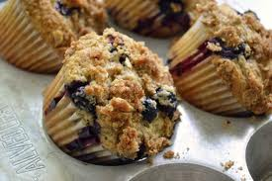
Muffins
There are many different muffin recipes.
The amount of ingredients varies, but the method of mixing is basically the same. The sugar, shortening, and salt are creamed together; the eggs are blended in; and the dry ingredients are sifted together and added alternately with the milk. All the mixing is done at slow or second speed with the paddle. The reaction of each ingredient within the batter is similar to that of the biscuit mix.
Proper mixing procedure is the key to a successful muffin. A common fault in mixing muffin batter is mixing the batter to a point where the gluten within the flour becomes tough. Gluten is the protein contained in flours. It provides structure for baked products. To prevent the gluten from becoming tough, the dry and liquid ingredients should be mixed together at slow speed with the paddle. Mix just enough to moisten, leaving the batter with a slightly rough appearance. The batter should not be smooth. Always use a scooper for consistent muffin size.

Slide 11
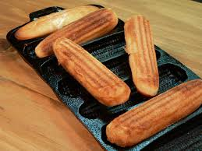
Corn Bread & Corn Sticks
Corn bread or corn sticks are quickbreads made from a batter containing flour and cornmeal as
well as eggs and oil. Corn bread and corn sticks are generally prepared using the same batter mix. In some cases, the consistency of the batter may be a little heavier when preparing corn sticks. The batter is made heavier by eliminating a small amount of the liquid. The recipes for preparing corn bread and corn sticks also vary in the mixing method. A recipe may call for a mixing method similar to muffins or for a three-stage method of blending an egg-milk mixture into the dry ingredients and stirring in melted shortening. The mixing should be done at slow or second speed using the paddle. The liquid must be added slowly because cornmeal does not absorb liquid very quickly. If the liquid is added too fast, lumps will form. Avoid overmixing by mixing the batter until fairly smooth.

Slide 12
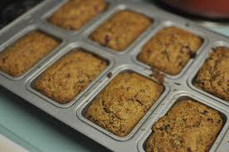
Quick Loaf Breads
A quick loaf bread is a quickbread that uses a batter similar to muffin batter. The shape is changed by baking the batter in a loaf pan. Quick loaf breads are so named because they contain a quick-acting leavening agent such as baking powder. Baking powder starts to rise as soon as heat is applied. These breads provide variety in appearance from the usually served muffin. They can be prepared using different fruits and nuts to produce a variety of flavors. Although quick loaf breads are similar to muffins in eating qualities and textures, they tend to stay fresh longer because of their size.
Quick loaf breads can be baked in a variety of loaf pans to create loaves of various sizes. Since the loaf is a fairly large unit, it can be frozen after baking with excellent results. If the loaves are not served immediately, they should be refrigerated after baking. This allows them to be sliced easier and thinner without crumbling. To extend the freshness of a quick loaf bread , line each pan with parchment paper for storage, or wrap the loaf tight when cool.

