Slide 1
Foods II
Soup Unit

Slide 2
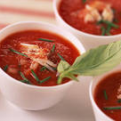
Soups are versatile foods that can range from flavorful broths to hearty chowders. Varieties are characterized by the finished appearance and consistency of the soup, and preparation and cooking methods used.

Slide 3
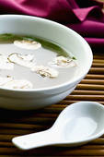
1. CLEAR SOUPS (commonly known as unthickened)
A stock-based soup with a thin, watery consistency.
2 Types:
Broths- produced from well-made stocks made from meat, poultry, seafood, or vegetables.
Consommés- are made from high-quality broths that have been further clarified to remove all impurities and surface fat.

Slide 4
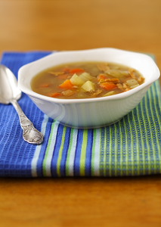
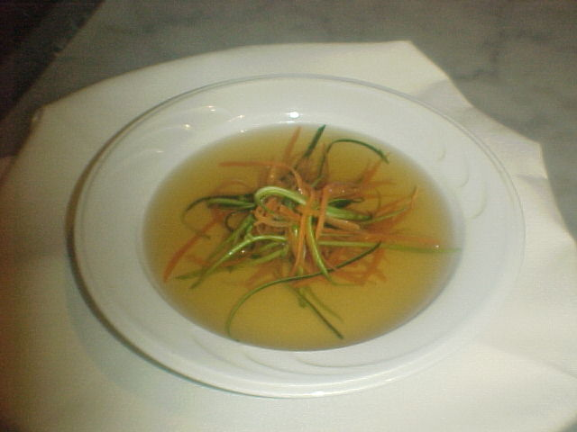
Components of Clear Soup
Preparation | Liquid | Ingredients
Broth (simmered) | Prepared stock (the strained liquid that results from cooking seasonings and vegetables or the bones of meat, poultry, or fish) | Meat, mirepoix pronounced "meer-pwah“ (cut of 25% carrots, 50% onion, and 25% celery used for flavor) Sachet d’epices (piece of cheesecloth filled with aromatic ingredients) Bouquet Garni (mix of fresh vegetables or herbs tied into bundle with butcher’s twine)
Consommé (simmered) | High-quality prepared broth of roasted meat or poultry | Clearmeat (cold meat, fish, or poultry that is combined with an acid such as wine, lemon juice, or tomato juice), mirepoix, sachet d’epices or bouquet garni, and oignon brule (means burnt onion, half of peeled onion that is charred on the cut-side in a heavy-bottomed pan, gives an intense roasted flavor and deeper color)

Slide 5
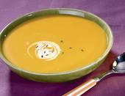
2. THICK SOUPS
A thick soup is a soup having a thick texture and consistency.
Two Types:
Cream soups often use an added starch, such as flour, to thicken them.
Puree soups are thickened by pureeing the main ingredients, which have starchy properties (potatoes, vegetables).
When making a thick soup always use a heavy-bottomed saucepot, preferably constructed of nonreactive stainless steel to avoid burning or scorching.

Slide 6
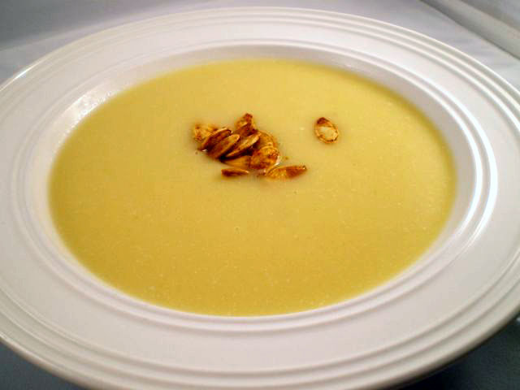
Cream Soup Preparation Methods
1. Veloute (Pronounced veh-loo-TAY) stock thickened with a roux. | Consists of simmering the main ingredient, such as asparagus for a cream of asparagus soup in a light veloute until tender. Then the main ingredient and the veloute are pureed, finished with cream, and seasoned to taste.
2. Roux (Pronounced roo) a cooked mixture of equal amounts by weight of flour and fat that is used to thicken sauces and soups. | Consists of sweating the main ingredient, such as asparagus, with an aromatic matignon- (uniformly cut mixture of onions, carrots, and celery) in butter. Next, flour is added to the mixture to make roux. Then hot stock is added to the roux, and the mixture is allowed to simmer and thicken. Finally, the soup is pureed until smooth and finished with cream.

Slide 7
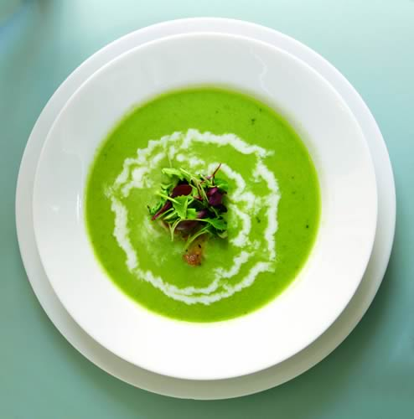
Puree Soups
Made by cooking starchy vegetables such as potatoes, squash, turnips, or carrots, or dried legumes such as lentils, beans, or split peas in broth until tender.
When the starchy ingredient is tender, the soup is pureed using all or a portion of the starchy ingredients to thicken the soup.
Neatness and accuracy of vegetable cuts are not priority in puree soups; however, preparing vegetables in relatively consistent size ensures uniform cooking.
Soup can contain many different ingredients from chilies to roasted vegetables. Pork products such as bacon, salt pork, and smoked ham are also often found in puree soups.

Slide 8
Controlling the Consistency of Soups
Thick soups tend to further thicken if they are made in advance and stored.
When it comes time to reheat, a small amount of hot water, stock, broth, hot milk, or cream may be added to thin the soup to desired consistency.
If a thick soup is too thin, a small amount of roux or cornstarch slurry (cold liquid mixed with cornstarch) may be whisked in and the soup brought to a simmer.

Slide 9
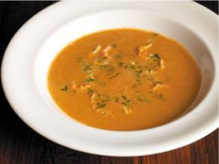
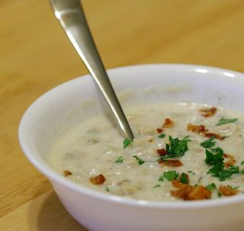
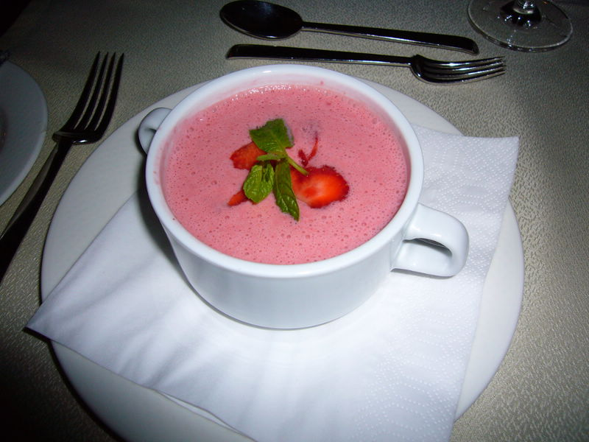
3. Specialty Soups
Bisque form of cream soup that is typically made from shellfish. | Although the name typically applies to soup made from shellfish, in modern cuisine many cream soups are referred to as bisques. Bisques are typically prepared using one of two methods, either a roux or a heavy cream reduction.
Chowders very hearty soup with large chunks of potatoes and other ingredients. | Most chowders are cream-based and very similar to cream soup, a few are broth-based and served thin. The majority of cream-based are thickened with roux. Chowders are not pureed unlike cream soups. Chowder is typically so hardy it can almost be thought of a variety of stew.
Cold soups Come in a variety of styles. | 2 main types: those that require cooking the main ingredients, and those that use fresh raw ingredients that are pureed. Many cold soups are made using fruit or vegetable juice.

