Slide 1
Specialty Desserts
Food Service Occupations 1

Slide 2
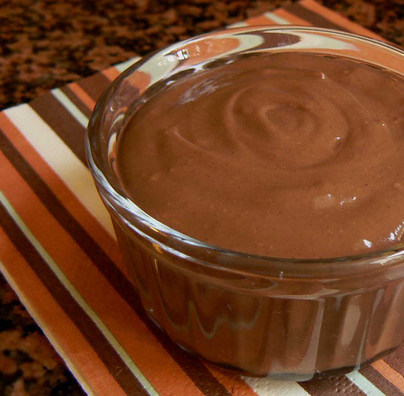
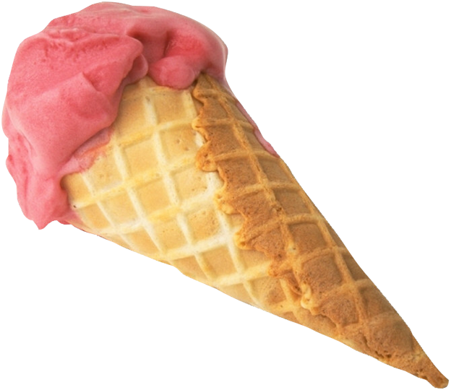
What are Specialty Desserts?
Specialty desserts include those dessert items not classified as cookies, pies, or cakes, such as puddings and ice creams.

Slide 3
Puddings
5 Types of pudding are commonly used in food service.
Cream or starch-thickened pudding: Include chocolate and vanilla pudding. Made from hot milk, sugar, starch, vanilla salt and eggs.
Baked pudding or egg-thickened pudding: Include rice pudding, bread pudding, and custard. Made from eggs and milk or cream and then baked.
Chilled pudding or gelatin pudding: Includes Bavarian cream, snow pudding and mousses. Very light and fluffy because whipped cream or egg whites are folded into mixture.
Soufflé pudding or soufflés: Includes chocolate and vanilla soufflé. Baked to order, uses egg whites folded into mixture. Very difficult to prepare
Steamed pudding or boiled puddings: Characteristically dark from brown sugar or molasses. Made with a large percentage of fruit, animal fat, flour, eggs and bread crumbs.

Slide 4
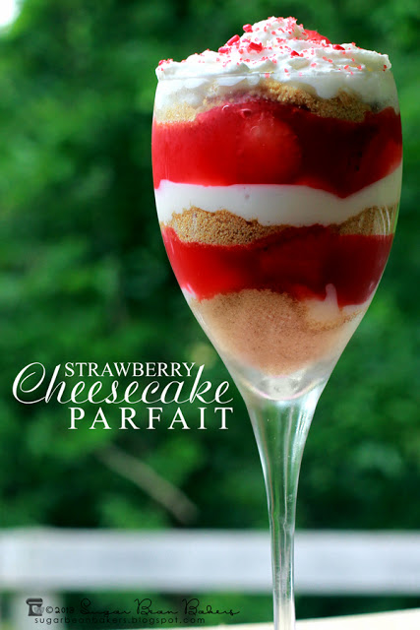
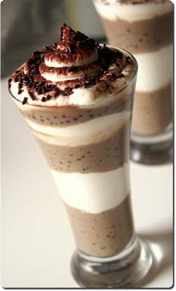
Parfaits
Parfaits are very eye appealing and elegant desserts. They can be made from ice cream, pudding, and other ingredients like cake, cookies, fruit, and whipped cream. The ingredients are layered in a bowl or glass, making levels inside the dessert.

Slide 5
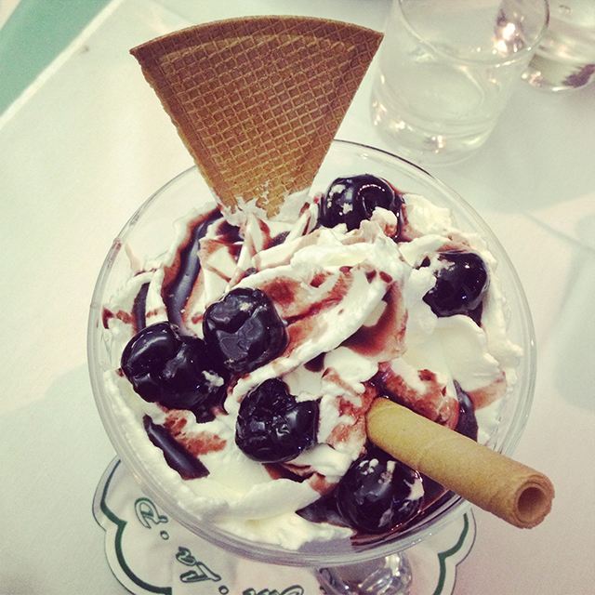
Coupes
Coupes are desserts combining ice cream or sherbet, liqueurs, sauces, fruit and whipped cream. They are served in glasses or silver cups. You might think of them as a “sundae”.

Slide 6
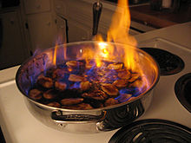
Jubilees
Jubilees are a combination of ice cream and a flaming liqueur fruit sauce that is poured over the ice cream in front of the guest. It is the most spectacular of the desserts and is very unique.

Slide 7
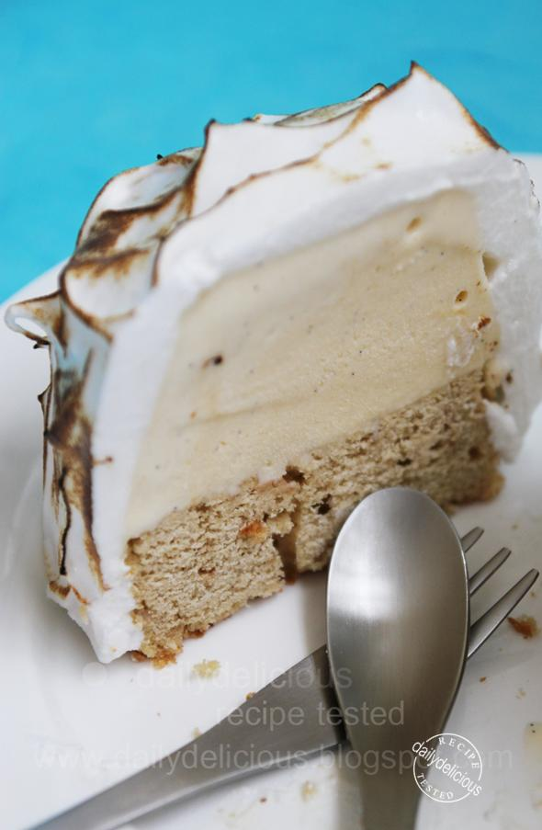
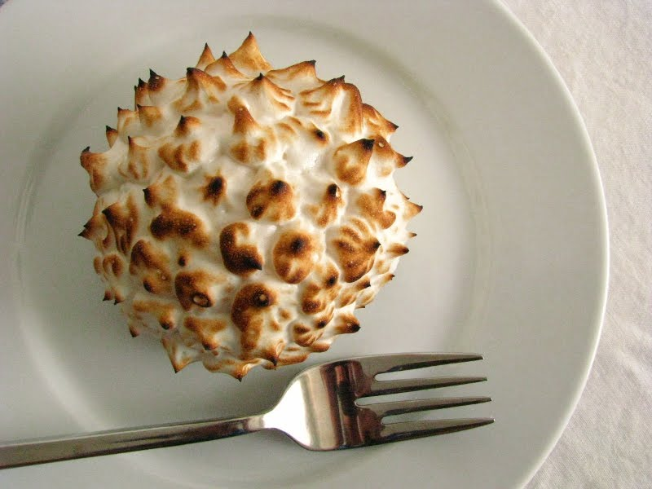
Baked Alaska
Combination of cake, ice cream and meringue. It has a solid ice cream center, golden brown outside and can be set on fire. It can be made like a cake and cut into individual slices, or it can be made into individual servings.

Slide 8
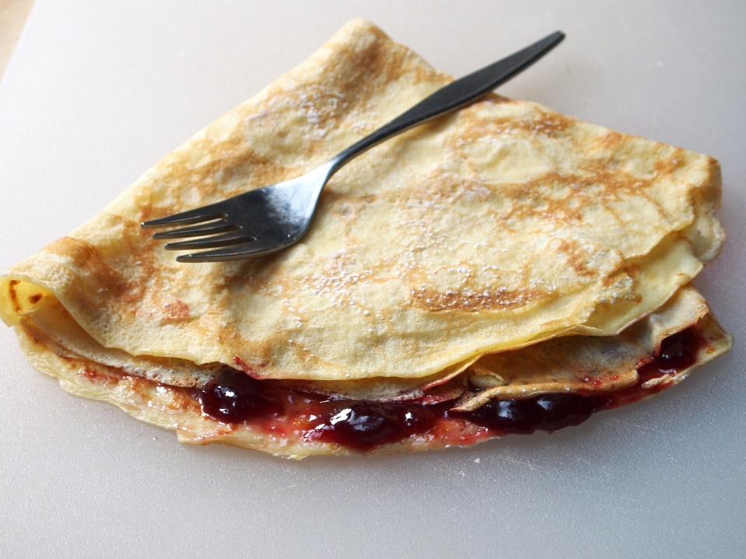
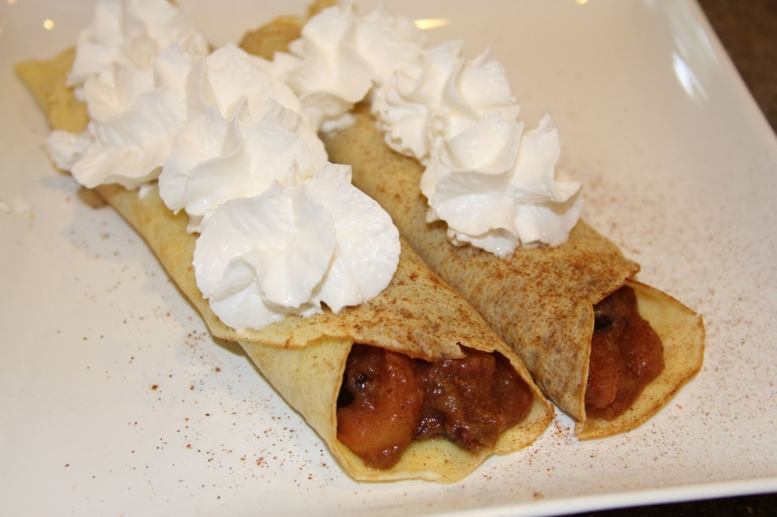
Crepe Desserts
Crepe desserts are thin French pancakes, which are topped with a sweet sauce or filling. They are either rolled or folded in four.

